Slide 1



INSTITUTE: UIE (AIT-CSE)
CSS21: B.E. CSE (H) with specialization in Artificial Intelligence & Machine Learning
Advanced Machine Learning (20CSF-349)
Chapter 2.3.5 & 2.3.6:Neural Networks
Lecture 28 & 29: Initialization and
Parameter Estimation - MLE, MAP
By: Mr. Siddharth Kumar
DISCOVER . LEARN . EMPOWER

Slide 2
Advanced Machine Learning
Course Outcome
CO | Title
1 | Have a good understanding of the fundamental issues and challenges of machine learning: data, model selection, model complexity, etc.
2 | Appreciate the underlying mathematical relationships within and across Machine Learning algorithms and the paradigms of supervised and un-supervised learning
3 | Design and implement various machine learning algorithms in a range of real-world applications.
4 | Design and evaluate intelligent expert models for perception and prediction using machine learning algorithms
5 | Analyze and make use of machine learning algorithms-based applications using performance

Slide 3
Neural Network Initialization
Initialization can have a significant impact on convergence in training deep neural networks. Simple initialization schemes have been found to accelerate training, but they require some care to avoid common pitfalls. In this post, we'll explain how to initialize neural network parameters effectively.
The importance of effective initialization
To build a machine learning algorithm, usually you’d define an architecture (e.g. Logistic regression, Support Vector Machine, Neural Network) and train it to learn parameters. Here is a common training process for neural networks:
Initialize the parameters
Choose an optimization algorithm
Repeat these steps:
Forward propagate an input
Compute the cost function

Slide 4
Compute the gradients of the cost with respect to parameters using backpropagation
Update each parameter using the gradients, according to the optimization algorithm
Then, given a new data point, you can use the model to predict its class.
The initialization step can be critical to the model’s ultimate performance, and it requires the right method. To illustrate this, consider the three-layer neural network below. You can try initializing this network with different methods and observe the impact on the learning.
How to find appropriate initialization values
To prevent the gradients of the network’s activations from vanishing or exploding, we will stick to the following rules of thumb:
The mean of the activations should be zero.
The variance of the activations should stay the same across every layer.

Slide 5
Why Weight Initialization?
Its main objective is to prevent layer activation outputs from exploding or vanishing gradients during the forward propagation. If either of the problems occurs, loss gradients will either be too large or too small, and the network will take more time to converge if it is even able to do so at all.
If we initialized the weights correctly, then our objective i.e., optimization of loss function will be achieved in the least time otherwise converging to a minimum using gradient descent will be impossible.
Different Weight Initialization Techniques
One of the important things which we have to keep in mind while building your neural network is to initialize your weight matrix for different connections between layers correctly.
Zero Initialization (Initialized all weights to 0)
Random Initialization (Initialized weights randomly)

Slide 6
Maximum Likelihood Estimation (MEP) VS Maximum A Posterior (MAP)
Maximum Likelihood Estimation (MLE) and Maximum A Posteriori (MAP), are both a method for estimating some variable in the setting of probability distributions or graphical models. They are similar, as they compute a single estimate, instead of a full distribution.
MLE, as we, who have already indulge ourselves in Machine Learning, would be familiar with this method. Sometimes, we even use it without knowing it.
Take for example, when fitting a Gaussian to our dataset, we immediately take the sample mean and sample variance, and use it as the parameter of our Gaussian.
This is MLE, as, if we take the derivative of the Gaussian function with respect to the mean and variance, and maximizing it (i.e. setting the derivative to zero), what we get is functions that are calculating sample mean and sample variance. Another example, most of the optimization in Machine Learning and Deep Learning (neural net, etc.), could be interpreted as MLE.

Slide 7
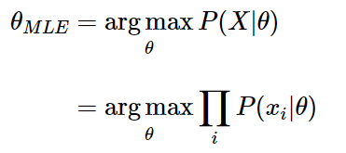
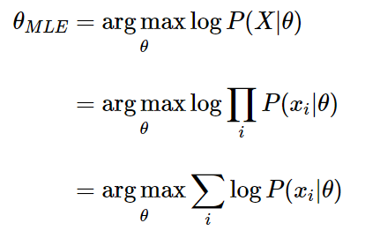
Speaking in more abstract term, let’s say we have a likelihood function P(X|θ). Then, the MLE for θ, the parameter we want to infer, is:
As taking a product of some numbers less than 1 would approaching 0 as the number of those numbers goes to infinity, it would be not practical to compute, because of computation underflow. Hence, we will instead work in the log space, as logarithm is monotonically increasing, so maximizing a function is equal to maximizing the log of that function.

Slide 8
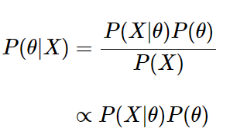
To use this framework, we just need to derive the log likelihood of our model, then maximizing it with regard of θ using our favorite optimization algorithm like Gradient Descent.
Up to this point, we now understand what does MLE do. From here, we could draw a parallel line with MAP estimation.
MAP usually comes up in Bayesian setting. Because, as the name suggests, it works on a posterior distribution, not only the likelihood.
Recall, with Bayes’ rule, we could get the posterior as a product of likelihood and prior:
We are ignoring the normalizing constant as we are strictly speaking about optimization here, so proportionality is sufficient.

Slide 9
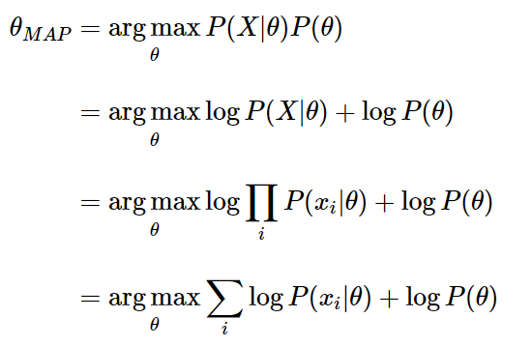
If we replace the likelihood in the MLE formula above with the posterior, we get:
Comparing both MLE and MAP equation, the only thing differs is the inclusion of prior P(θ) in MAP, otherwise they are identical. What it means is that, the likelihood is now weighted with some weight coming from the prior.

Slide 10
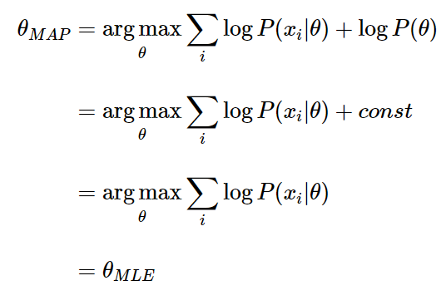
Let’s be more concrete, let’s say we could assign six possible values into θ. Now, our prior P(θ) is 1\6 everywhere in the distribution. And consequently, we could ignore that constant in our MAP estimation.
We are back at MLE equation again!
If we use different prior, say, a Gaussian, then our prior is not constant anymore, as depending on the region of the distribution, the probability is high or low, never always the same.
What we could conclude then, is that MLE is a special case of MAP, where the prior is uniform!

Slide 11
References
T1: Mitchell T.M., Machine Learning, McGraw Hill (1997).
T2: Andreas C. Miller, Sarah Guido, Introduction to Machine Learning with Python, O’REILLY (2001).
Notes:
Introduction to Cyber Security (simplilearn.com)

Slide 12

THANK YOU

